Slide 1
Foreign and digital currency exchange (FDCX)
Project by: Adil Nadeem, Affan Ahmad, and Tehreem Shakeel

Slide 2
What is FDCX?

Slide 3

Our goal central place of currency exchange avoid long, in person queues automate and regulate transactions

Slide 4
Key features of FDCX
Trade Digital and Foreign Currency
View Tax Reports
Regulated by National Authorities
Value Predictions
Various Subscription Plans

Slide 5
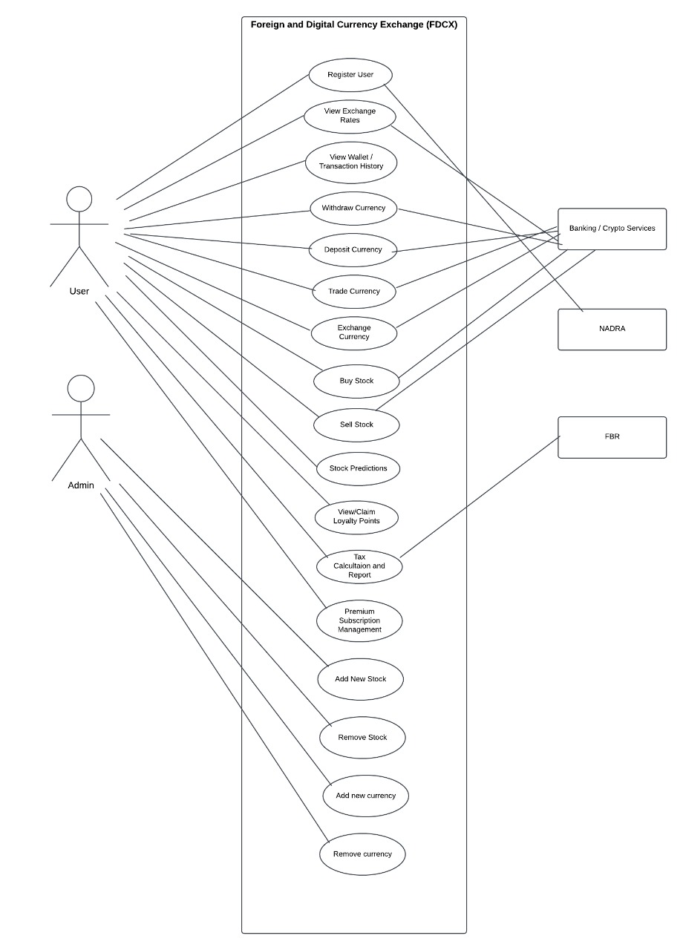
USE CASE DIAGRAM

Slide 6
MAIN USE CASE: TRADE STOCKS
User is prompted to buy or sell stocks
Upon selection, user can buy or sell preferred stocks
Changes are reflected on user account, and stocks accordingly

Slide 7
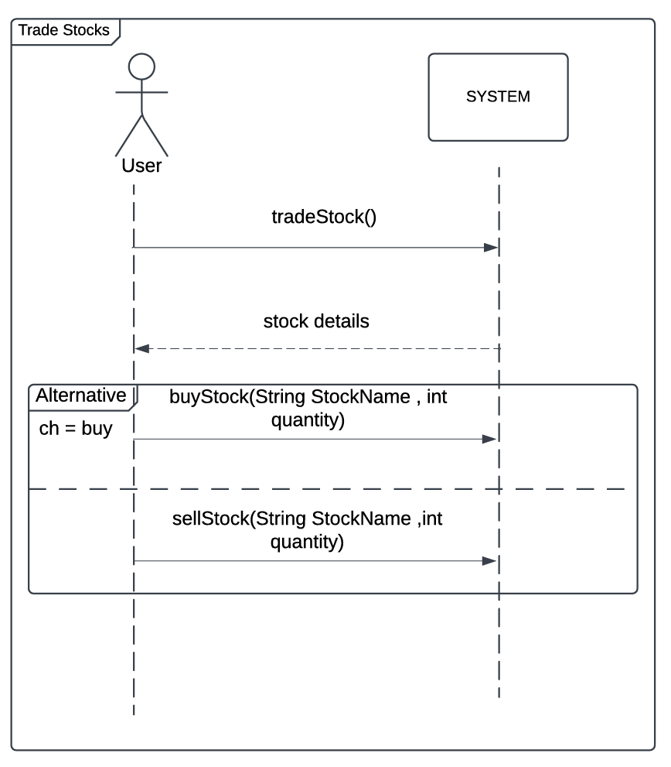
System sequence diagram

Slide 8
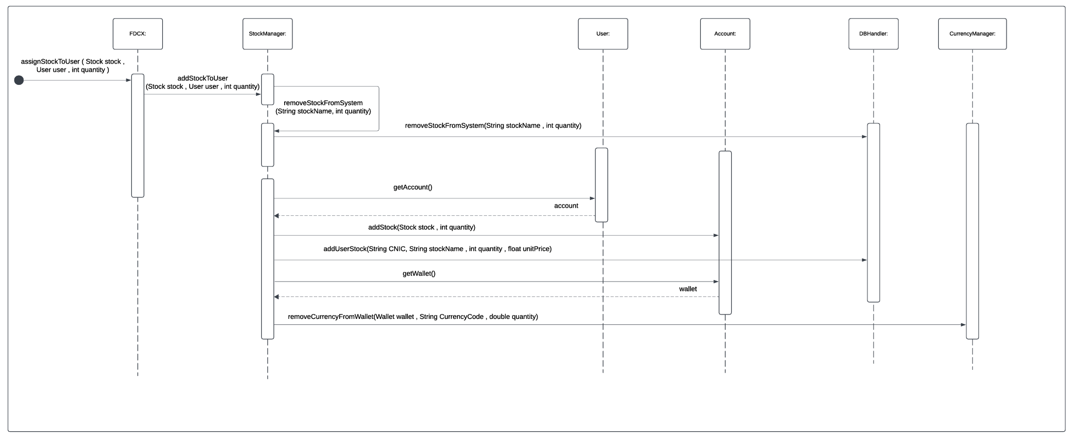
Buying stocks sequence diagram

Slide 9
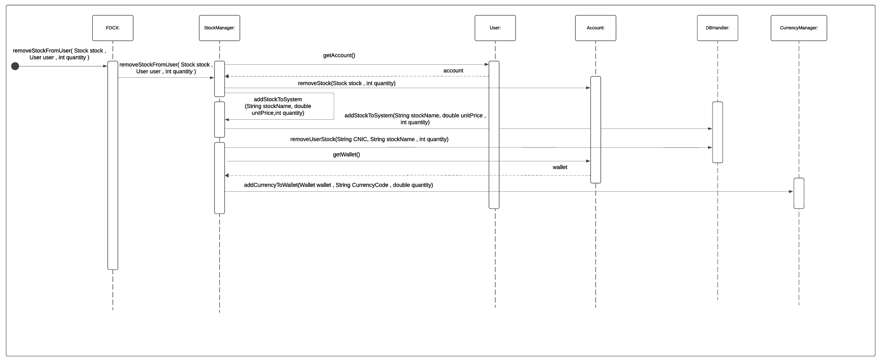
Selling stocks sequence diagram

Slide 10
THANK YOU

